Slide 1


SAP Full-Stack Developer
Training
ABAP on HANA, UI5 & Fiori, Analytics with OData
Anubhav Oberoy
Day – 6

Slide 2

Agenda – Day 6
System architecture
Fiori App Ref. Library
How to find standard app and its configuration
Activating services
SAP Fiori Standard App Implementation
Example app – Create Sales order Fiori Apps
---Break---
What SAP fiori element
Advantage of Fiori Elements
Fiori Element v/s Free style App
Example scenario for Products
Create List Report Fiori Elements App

Slide 3
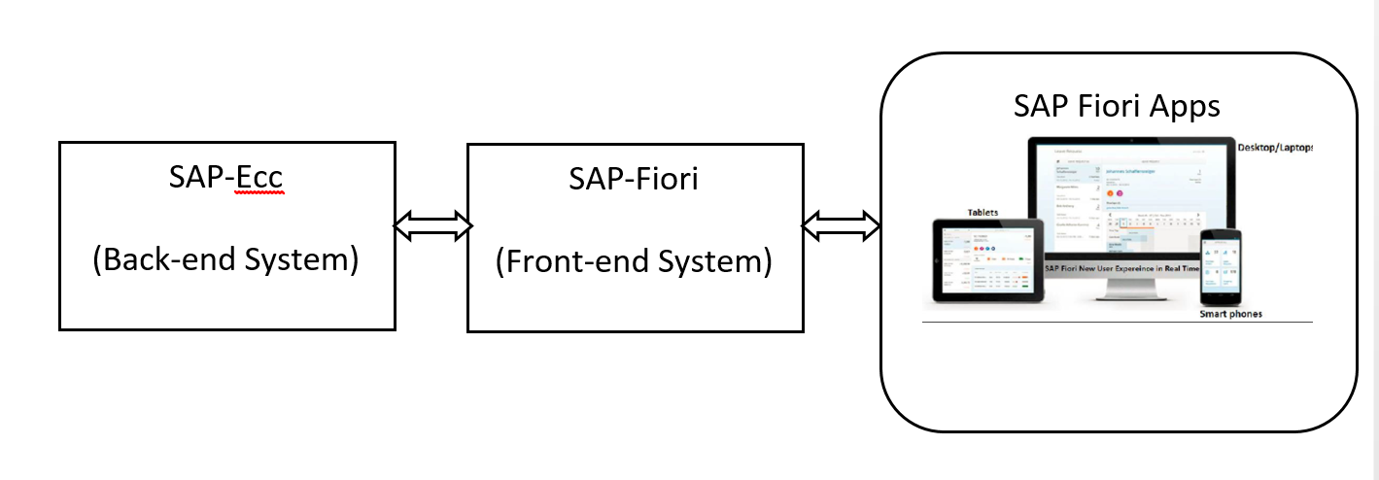
SAP Fiori Standard App Implementation
SAP Fiori is a new user experience (UX) for SAP software and applications.
It provides a set of applications that are used in regular business functions like work approvals, financial apps, calculation apps and various self-service apps.
SAP Fiori Apps can be accessed on desktops, Mobile or tablets.
These are web-based applications hosted on SAP-Fiori server (front-end system) and access business data from SAP-ECC(back-end system).

Slide 4
Two types of SAP-Fiori app implementations:
Standard Apps
Implementation of those business apps, which are released by SAP. These are categorized as Transnational, Fact-sheets and Analytical apps etc.
Customized Apps
As per business requirement, a complete custom fiori app can be implemented.
Customized App is been hosted on SAP-Fiori server (front-end system).
It integrates with SAP or Non-SAP system.

Slide 5
Pre-requisites for Standard Fiori App
SAP ECC Server (Back-end)
SAP Fiori Server (Front-end)
SAP Fiori Launchpad Url:
1. http://<host>:<port>/sap/bc/ui5_ui5/ui2/ushell/shells/abap/FioriLaunchpad.html
SAP Fiori Designer Url:
http://<host>:<port>/sap/bc/ui5_ui5/sap/arsrvc_upb_admn/main.html
Important T-codes:
SrNo | T-code | Description
1 | SICF (Path: /sap/bc/ui5_ui5/sap/) | UI5 Application Path
2 | SICF (Path: /sap/opu/odata/sap/) | Odata Service Path
3 | /n/iwfnd/maint_service | Odata Service Registration
4 | /n/UI2/SEMOBJ_SAP | Semantic objects by SAP
5 | /n/iwfnd/error_log | Error Log
6 | LPD_CUST | Launchpad Role
7 | PFCG | PFCG Role
Trainer: Anubhav Oberoy

Slide 6
Standard Fiori app components
Software Components
Back-End Components
Back-End Software Components
OData Service
Components
Front-End Software Components
Back-End Authorization Role (PFCG)
Front-End Components
SAP UI5 Application
OData Service Registration
Business Catalog
Front-End Business Role (PFCG)
Trainer: Anubhav Oberoy

Slide 7
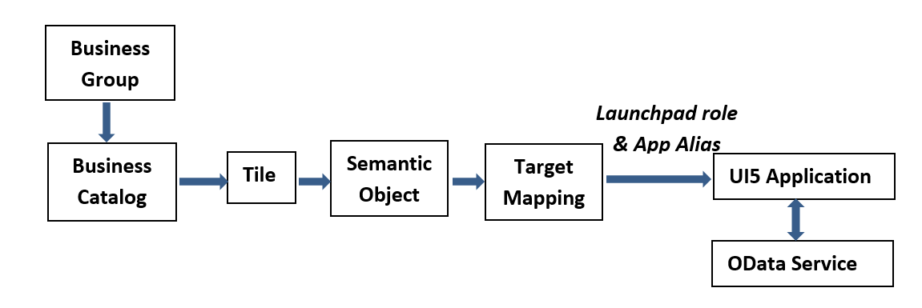
Relationship between Front-End Components
Trainer: Anubhav Oberoy

Slide 8

SAP Fiori Custom App development
Customized App is been hosted on SAP-Fiori server (front-end system).
It integrates with SAP or Non-SAP system.
Trainer: Anubhav Oberoy

Slide 9
Customized Fiori app components
Software Components
Back-End Components
Front-End Components
Back-End Components
Back-End Software Components
OData Service
SAP UI5 Application
OData Service definition & its registration
Semantic Object
Launchpad Role
App accessibility in Fiori Launchpad
Business Catalog
Tile
Target Mapping
Business Group
Front-End Business Role (PFCG)
Components
For data access from SAP System
RFC
For data access from Non-SAP System
Web-services etc.
Front-End Software Components
Back-End Authorization Role (PFCG)
Front-End Components
Front-End Business Role (PFCG)
Trainer: Anubhav Oberoy

Slide 10
Pre-requisites for Customized Fiori App
SAP or Non-SAP system’s data interchange technique like RFC, webservice etc.
Eclipse with SAP UI5 Development Tool Kit
SAP Fiori Server (Front-end)
SAP Fiori Launchpad Url:
http://<host>:<port>/sap/bc/ui5_ui5/ui2/ushell/shells/abap/FioriLaunchpad.html
SAP Fiori Designer Url:
http://<host>:<port>/sap/bc/ui5_ui5/sap/arsrvc_upb_admn/main.html
Trainer: Anubhav Oberoy

Slide 11
Important T-codes of SAP Fiori Server
 | Front-End server (T-code) | Description
1 | SICF (Path: /sap/bc/ui5_ui5/sap/) | UI5 Application Path
2 | SICF (Path: /sap/opu/odata/sap/) | Odata Service Path
3 | SEGW | Create Odata Service
4 | /n/iwfnd/maint_service | Odata Service Registration
5 | /n/iwfnd/gw_client | Test Odata Service
6 | /n/iwfnd/error_log | Error Log
7 | SE38 (Report: /UI5/UI5_REPOSITORY_LOAD) | To upload/Download/Delete UI5 Application
8 | /n/UI2/SEMOBJ | Semantic objects by SAP
9 | LPD_CUST | Launchpad Role
10 | PFCG | PFCG Role
Trainer: Anubhav Oberoy

Slide 12
Steps to create/configure a custom Fiori App
Create UI5 Application in Eclipse
Deploy UI5 Application in SAP-Fiori
(front-end) server
Steps
Create custom OData Service
Register custom OData Service in
SAP-Fiori (front-end) server
App access configuration in
SAP-Fiori-Launchpad
Trainer: Anubhav Oberoy

Slide 13

Break
Trainer: Anubhav Oberoy

Slide 14
SAP Fiori Element
SAP Fiori elements is a framework that comprises the most commonly used floorplan templates and is designed to:
Speed up development by reducing the amount of frontend code needed to build SAP Fiori apps.
Drive UX consistency and compliance with the latest SAP Fiori design guidelines.
Each version of SAP Fiori elements supports a different version of OData (Open Data Protocol), as their names indicate:
SAP Fiori elements for OData version 2 (V2)
SAP Fiori elements for OData version 4 (V4)
Fiori Elements are reusable templates, the main benefit is to:
Reduce the maintenance as there is no need to develop the JS code
Application standardization
Reduce effort in development
Using annotation makes its independent of UI technology
Fiori Apps
Data Source Exposes the OData Service
SEGW Service | CDS View based Service
Trainer: Anubhav Oberoy

Slide 15
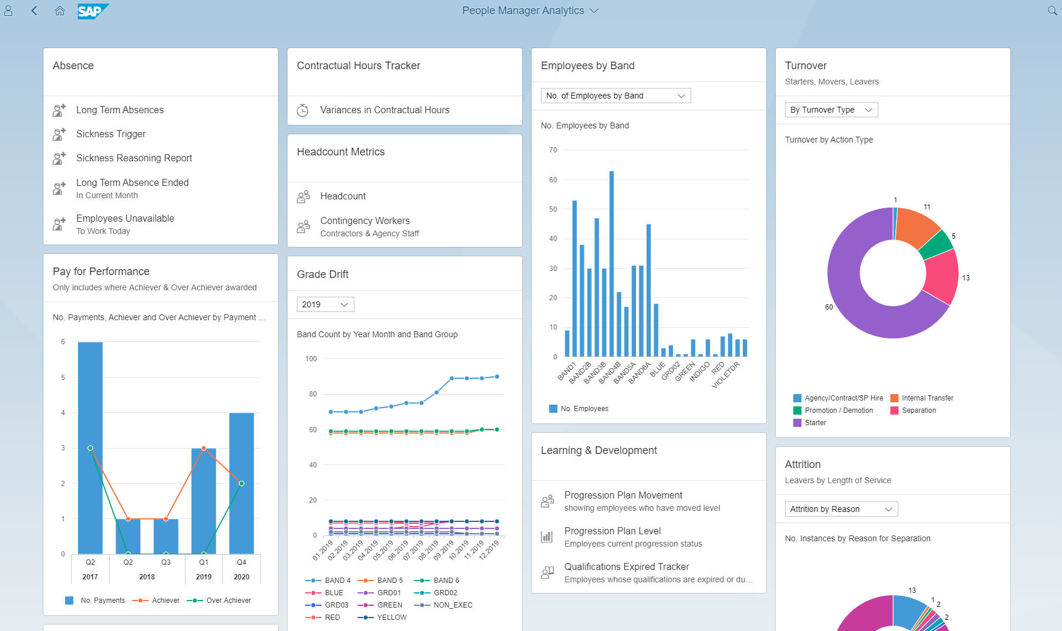
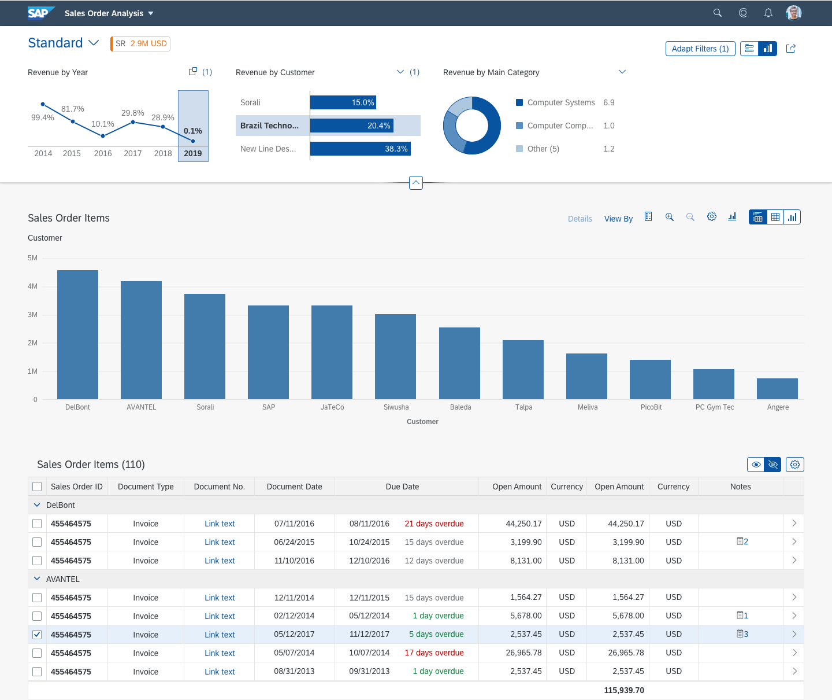
SAP Fiori Element App looks like as:
Trainer: Anubhav Oberoy

Slide 16
Annotation
Annotation files are usually defined as data sources in manifest. Json.
Semantic business layer which independent of UI the layer
In the dataSources definition of the OData service, you can reference these annotation data sources in the annotations setting.
Metadata annotations can be used to define additional characteristics or capabilities of a metadata element, such as a service, entity type, property, function, action or parameter.
The Fiori has standard elements aps like:
1. List Report
2. OVP – Over view pages
3. ALP – Analytic List page
CDS View : Core Data Service in SAP S/4HANA system, is one best way to push down logic to SAP HANA
Documentation Link: https://help.sap.com/viewer/cc0c305d2fab47bd808adcad3ca7ee9d/7.5.9/en-US/f8af07bb0770414bb38a25cae29a12e9.html
Trainer: Anubhav Oberoy

Slide 17
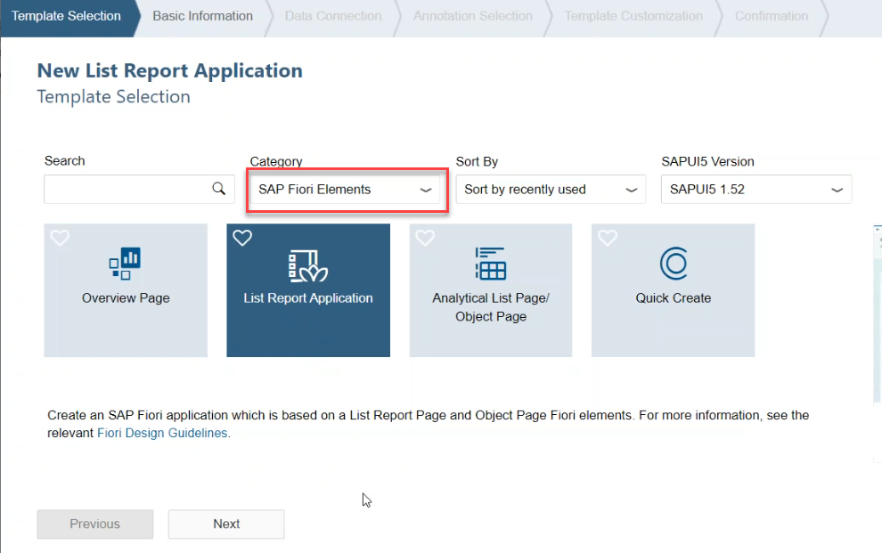
Create a Fiori Element Application
Steps:
Go to WebIDE and Create a new project from template.
Select Category as SAP Fiori Elements
Fill all the required details and Select a particular service name
Trainer: Anubhav Oberoy

Slide 18
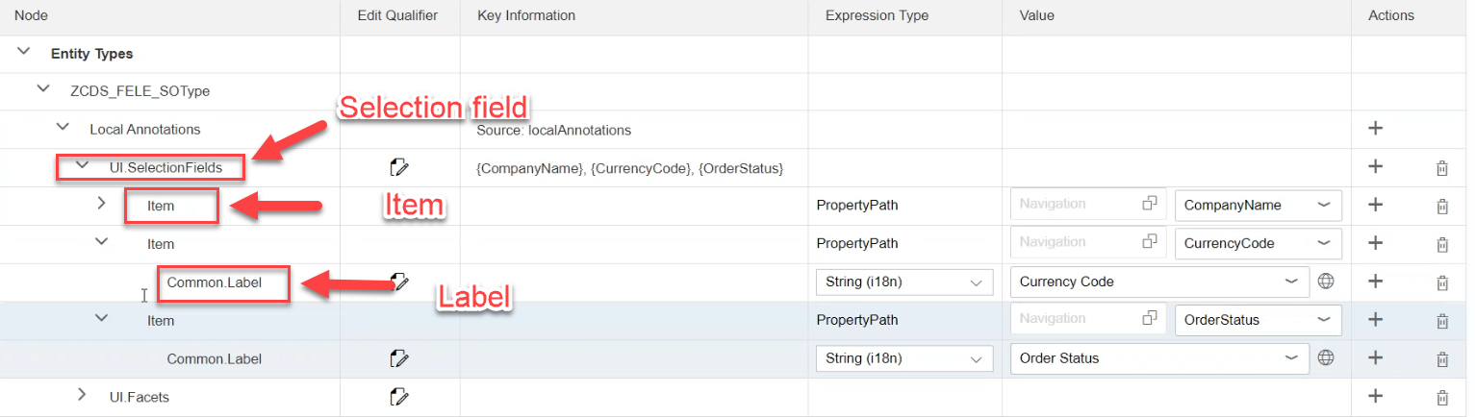
Add Selection field in Fiori Element App:
Go to annotations Folder and open file
Add a Selection field:
Click on + button of Local Annotation and select Selection Field
Click on + of Selection field and choose Item and Fill property path and
Give the label of item using click on + of Item
Trainer: Anubhav Oberoy

Slide 19
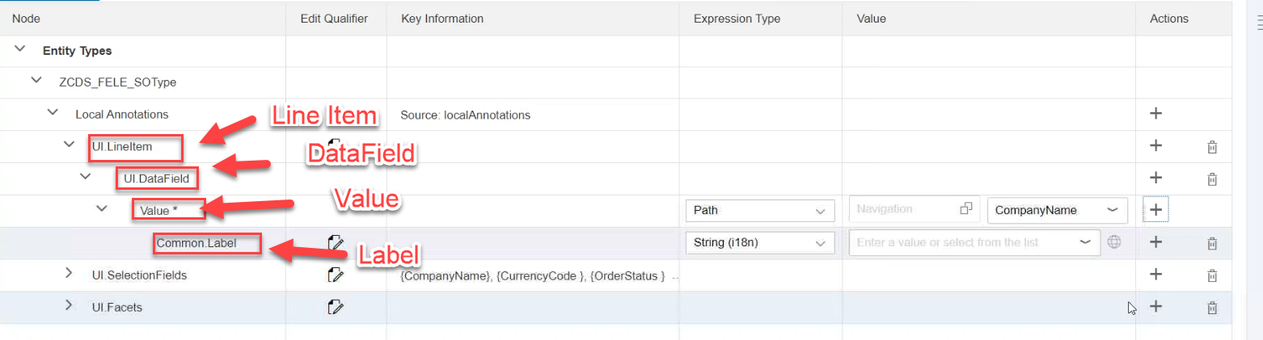
Add LineItem annotations:
Click on + button of Local Annotation and Select LineItem
Add a column in LineItem then click on + of LineItem and Choose DataField
Give label name of data field
Click on + of value and choose label
Trainer: Anubhav Oberoy

Slide 20
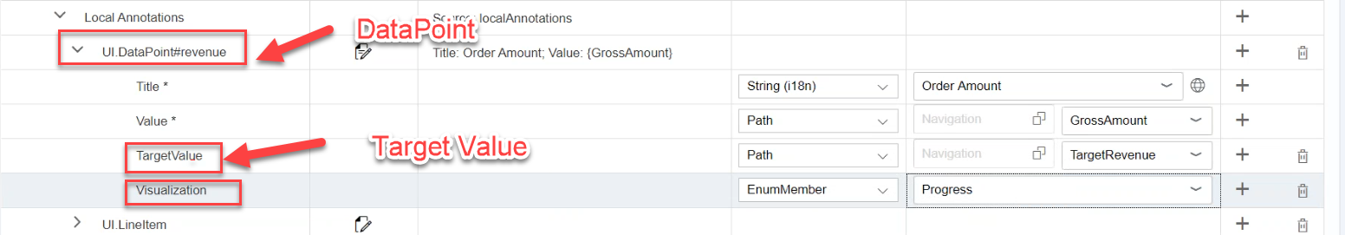
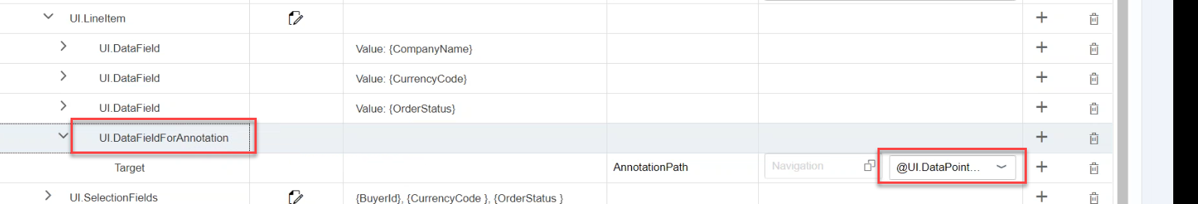
Represent DataPoint
Click on + on Local Annotations and choose DataPoint
Edit name of this field
Click + on DataPoint and choose TargetValue
Show the data:
Click + on DataPoint and Select any Property like Visualization
Trainer: Anubhav Oberoy

Slide 21

End of Day 6

Slide 22

Questions

Slide 23

Anubhav Oberoy

Slide 24


We’re committed to empower you to be
Most Desirable Resource
through powerful training solutions.
We build the workforce of the future.
250+
Corporate Clients
30,000+
Learners Trained
25000+
Learners Placed
FREE WEBINARS
Sign up for free webinars with industry experts every fortnight!
Enroll Now!
Contact us today!
https://anubhavtrainings.com/

Slide 25




More from AnubhavTrainings.com

